Slide 1
P&S Modern SSDs Understanding and Designing Modern NAND Flash-Based Solid-State Drives
Dr. Jisung Park
Prof. Onur Mutlu
ETH Zürich
Spring 2022
18 March 2022

Slide 2
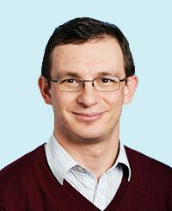
Course Info: Who Are We? (I)
Onur Mutlu
Full Professor @ ETH Zurich ITET (INFK), since September 2015
Strecker Professor @ Carnegie Mellon University ECE/CS, 2009-2016, 2016-…
PhD from UT-Austin, worked at Google, VMware, Microsoft Research, Intel, AMD
https://people.inf.ethz.ch/omutlu/
omutlu@gmail.com
https://people.inf.ethz.ch/omutlu/projects.htm
Research and Teaching in:
Computer architecture, computer systems, hardware security, bioinformatics
Memory and storage systems
Hardware security, safety, predictability
Fault tolerance
Hardware/software cooperation
Architectures for bioinformatics, health, medicine
…

Slide 3
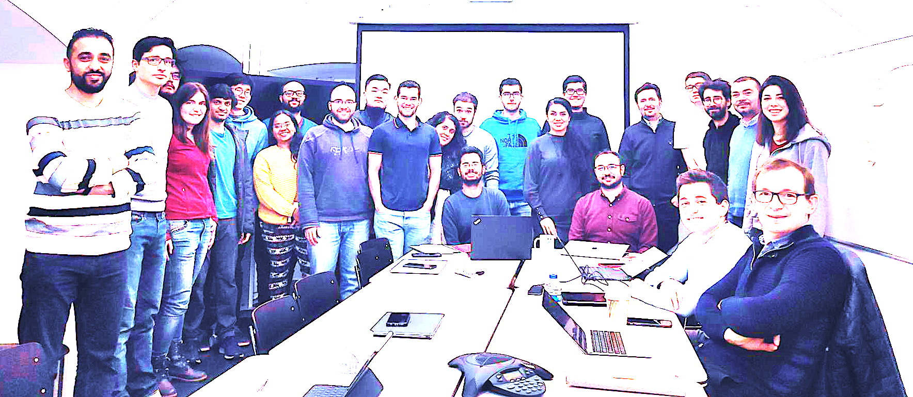

Onur Mutlu’s SAFARI Research Group
Computer architecture, HW/SW, systems, bioinformatics, security, memory
8 Postdoc, 13 PhD Students, 7 MS Students, 6 Affiliated Researchers
Think BIG, Aim HIGH!
https://safari.ethz.ch

Slide 4

SAFARI Newsletter: December 2021
https://safari.ethz.ch/safari-newsletter-december-2021

Slide 5
Course Info: Who Are We? (II)
Dr. Jisung Park
Senior researcher and lecturer @ SAFARI research group since 2019
PhD from Seoul National University
Research Area: computer architecture, system software, memory/storage systems, system security, and HW/SW cooperation
http://jisungpark.kr/
jisung.park@safari.ethz.ch

Slide 6
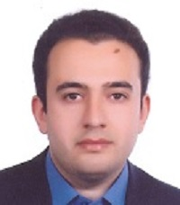
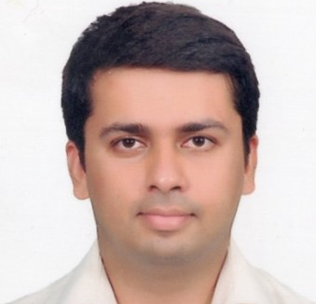
Course Info: Who Are We? (III)
Dr. Mohammad Sadrosadati
Senior researcher @ SAFARI research group since 2021
Senior researcher @ IPM 2019–2021
PhD from Sharif University of Technology
Research Area: energy-efficient GPUs, solid-state drives, processing-in-memory, machine learning
m.sadr89@gmail.com
Rakesh Nadig
PhD Student @ SAFARI research group since 2021
Senior staff engineer @ Samsung Electronics India 2014-2021
MS from University of California Irvine
Research Area: computer architecture, memory system design, multi-core architectures, near-memory processing, non-volatile memory
rakesh.nadig@safari.ethz.ch

Slide 7
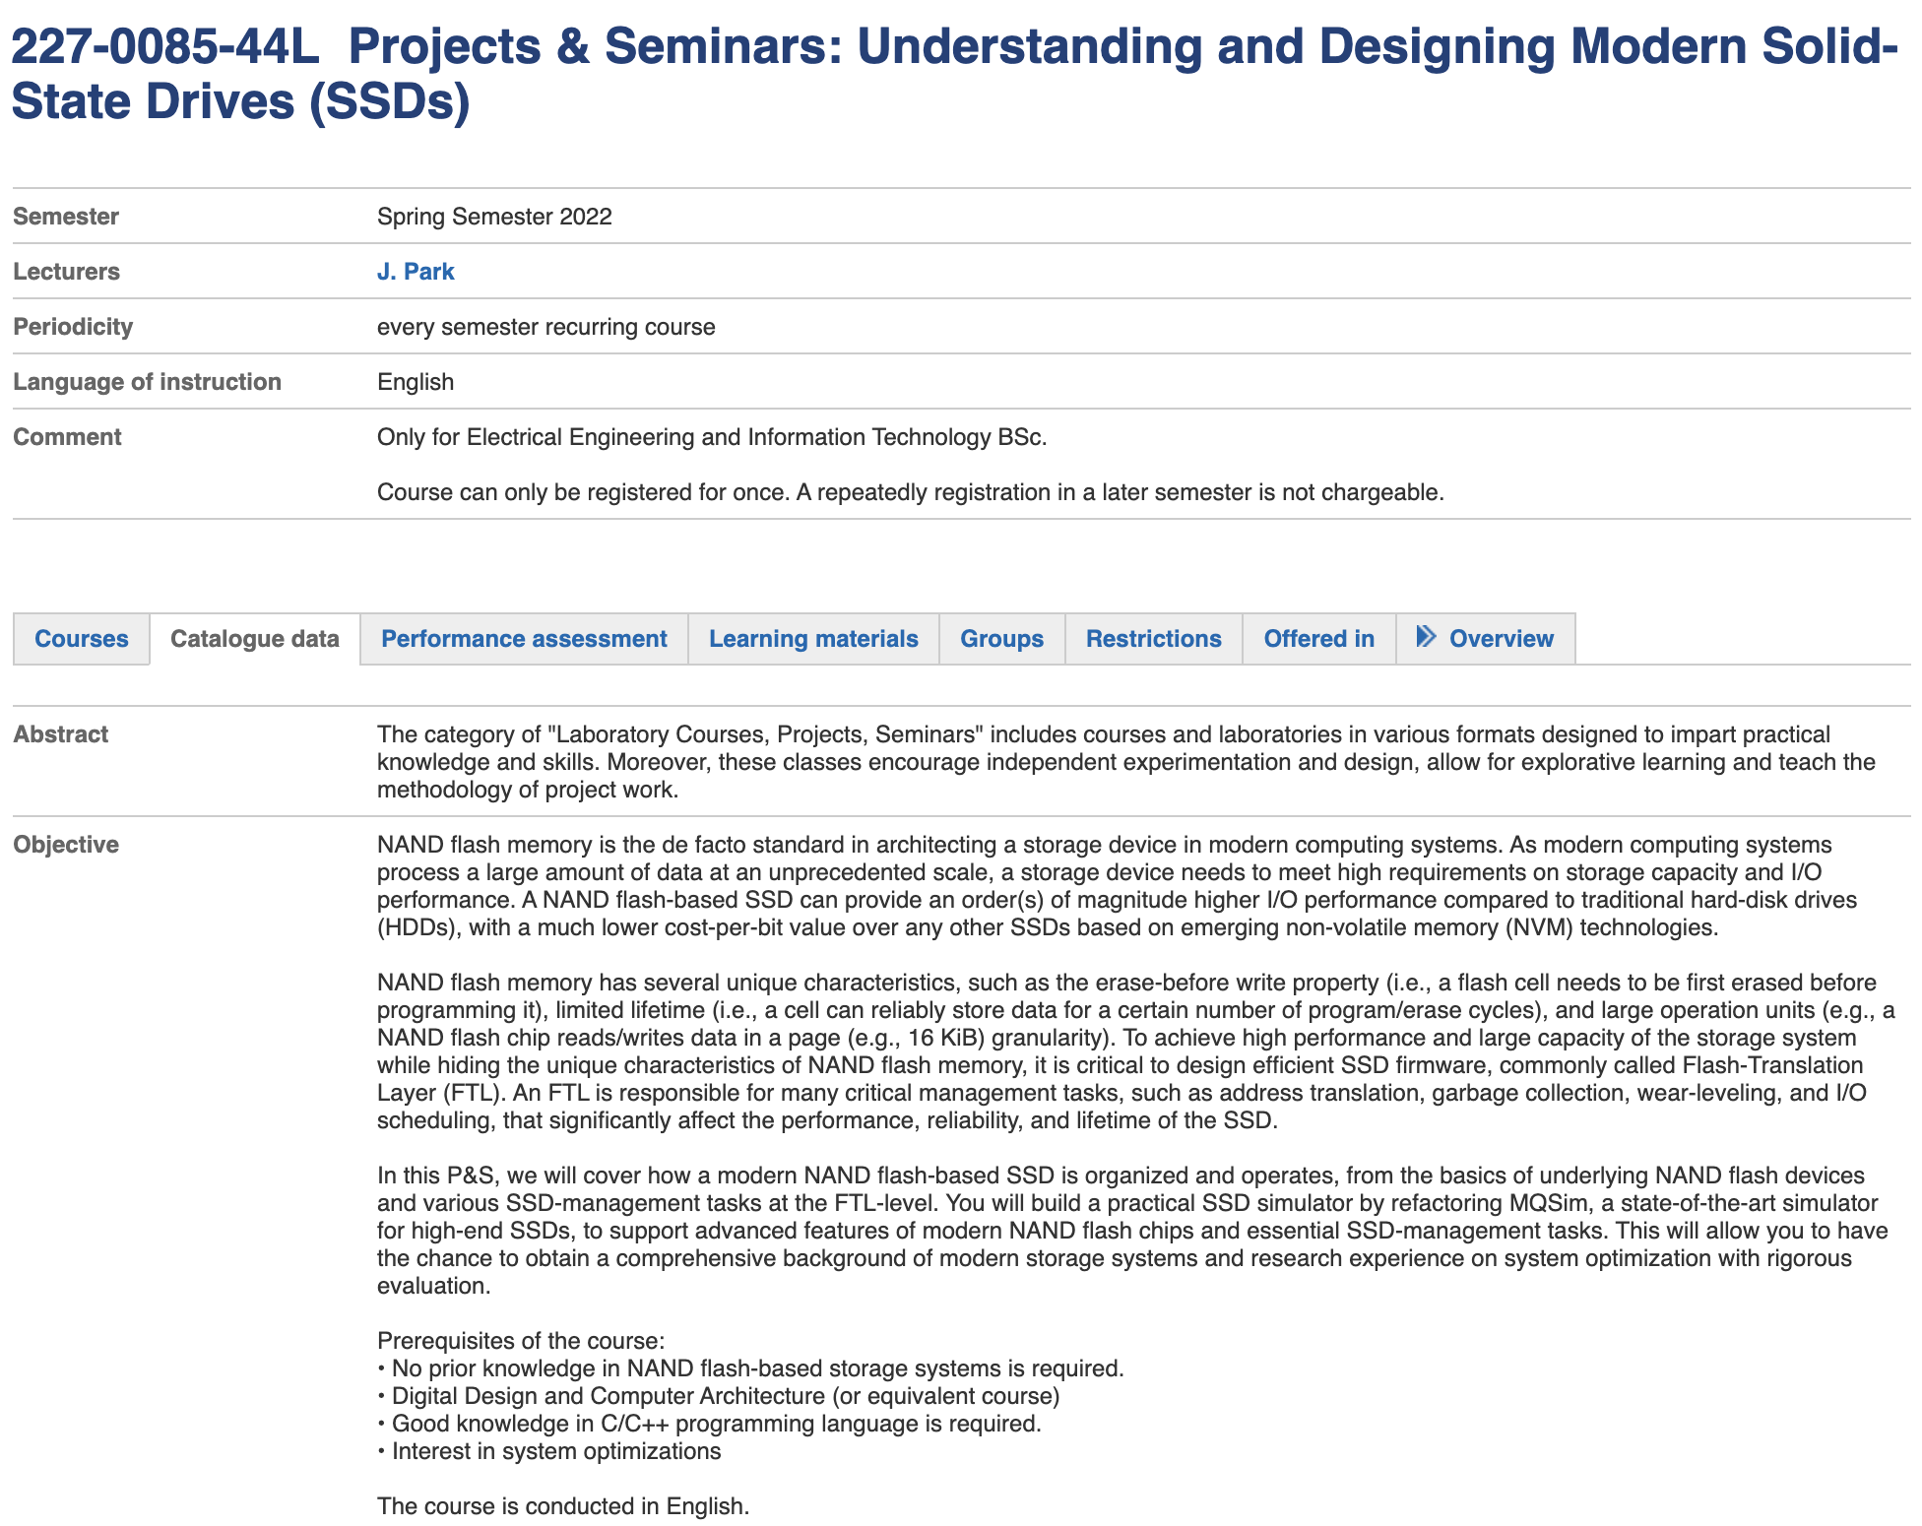
P&S: Modern SSDs (I)
http://www.vvz.ethz.ch/Vorlesungsverzeichnis/lerneinheit.view?lang=en&semkez=2022S&ansicht=KATALOGDATEN&lerneinheitId=157085&

Slide 8
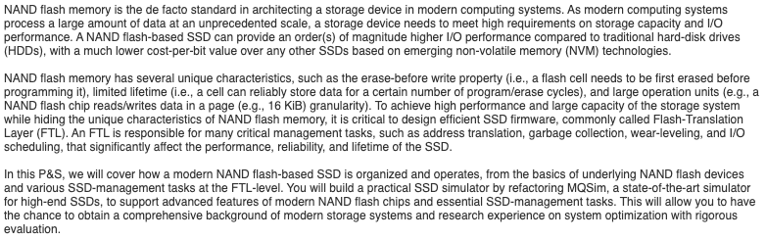
P&S: Modern SSDs (II)

Slide 9
P&S Modern SSDs: Contents
We will introduce how a modern NAND flash-based SSD is organized and operates to provide high I/O performance while hiding unique characteristics of NAND flash memory
You will learn fundamentals and challenges in designing modern SSDs
You will review existing approaches that are widely adopted in modern SSDs and will get familiar with new research proposals
You will work hands-on: refactoring MQSim, a state-of-the-art SSD simulator

Slide 10
Modern SSD Architecture
A modern SSD is a complicated system that consists of multiple cores, HW controllers, DRAM, and NAND flash memory packages
0.001×1,024 = 1 GB
8×128 GB = 1 TB
SSD Controller
LPDDR DRAM
NAND Packages
Core
Core
Core
HW
Flash Ctrl.
HW
Flash Ctrl.
HW
Flash Ctrl.
HW
Flash Ctrl.
Request Handler
ECC/Randomizer
Encryption Engine
Samsung PM853T 960GB Enterprise SSD (from https://www.tweaktown.com/reviews/6695/samsung-pm853t-960gb-enterprise-ssd-review/index.html)

Slide 11
Why So Complicated?
To provide backward compatibility with traditional HDDs
Smaller sectors than file-system blocks: 512 Bytes vs. 4KiB
Support overwrites
While hiding unique characteristics of NAND flash memory
Large operation units
Erase-before-write property
Asymmetry in operation units
Limited endurance
Various error sources
Asymmetry in operation latencies

Slide 12
Unique Characteristics of NAND Flash (I)
Large operation units
Read/write granularity: page (4 – 16 KiB)
Erase-before-write property
A page needs to be first erased before programming
Operation-unit asymmetry
Erase granularity: block (hundreds or thousands of pages)
In-place update (i.e., overwrite) is very inefficient for NAND flash memory → Out-of-place write & garbage collection

Slide 13
Unique Characteristics of NAND Flash (II)
Limited endurance
A flash cell cannot reliably store data after experiencing a certain number of program and erase (P/E) cycles
SLC (Single-Level Cell): > 100K P/E cycles
MLC (Multi-Level Cell): ~ 10K P/E cycles
TLC (Triple-Level Cell): < 3K P/E cycles
QLC (Quad-Level Cell): < 1K P/E cycles
Requires proper lifetime management techniques
(e.g., wear-leveling)

Slide 14
Flash Translation Layer (FTL)
Sophisticated SSD firmware
Logical Block (4 KiB, overwrittable)
…
Storage-device view at operating systems: A series of blocks
Flash Translation Layer (FTL)
Address translation (out-of-place write)
Garbage collection
Lifetime management (Wear-leveling)
Reliability management (ECC, data refresh)
I/O scheculing
NAND Flash
Chip
NAND Flash
Chip
NAND Flash
Chip
NAND Flash
Chip
NAND Flash
Chip
…

Slide 15
SSD Opimization
Requires comprehensive understandings of
Microarchitecture of underlying NAND flash chips (HW)
Various internal management tasks (HW and SW)
OS & workload characteristics (SW)
Optimization at one level may affect and/or be affected by the efficiency of designs at other levels.
We need an SSD simulator that accurately models various functionalities and components

Slide 16
What You Will Do
Phase 1: Learning fundamentals of NAND flash-based SSDs
3–4 background lectures on
Organization of NAND flash memory and NAND flash-based SSDs
NAND flash operations
SSD management tasks
Literature review
Phase 2: Refactoring MQSim
Improving coding convention
Removing complicated features
For better readability and extendibility

Slide 17
Key Takeaways
This P&S aims at improving your
Knowledge in Computer Architecture with a focus on modern storage systems
Technical skills required for good research
Critical thinking and analysis

Slide 18
Prerequisites of the Course
Digital Design and Computer Architecture (or equivalent course)
Familiarity with C++ programming (or high motivation to acquire it)
Interest in
Computer architecture and systems
Discovering why things do or do not work
Solving problems
Designing an efficient and practical system

Slide 19
Course Info: How About You?
Let us know your background, interests
Why did you join this P&S?
HW0 – Student Information (Due: 24 March 2022)

Slide 20
Course Requirements and Expectations
Attendance required for all meetings
Study the learning materials
Each student will work on a hands-on project
Participation
Ask questions, contribute thoughts/ideas

Slide 21
Course Website
https://safari.ethz.ch/projects_and_seminars/spring2022/doku.php?id=modern_ssds
Useful information about the course
Check your email frequently for announcements

Slide 22
Meeting 1
Required Materials
Arash Tavakkol, Juan Gomez-Luna, Mohammad Sadrosadati, Saugata Ghose, and Onur Mutlu, "MQSim: A Framework for Enabling Realistic Studies of Modern Multi-Queue SSD Devices," In USENIX FAST, 2018.
MQSim GitHub Repository: https://github.com/CMU-SAFARI/MQSim
Recommended Materials
Computer Architecture Fall 2020 – Lecture 26: Flash Memory and Solid-State Drives
https://www.youtube.com/watch?v=rninK6KWBeM
PDF and PPT
Computer Architecture Fall 2020 – Lecture 14: Simulation (with a Focus on Memory)
https://www.youtube.com/watch?v=3cI4zOoDk9Q
PDF and PPT

Slide 23
Next Meetings
We will meet weekly: Friday 10 AM
Provide background lectures
Discuss what each of you has done in the previous week
Q&A for any difficulties in the previous week and directions for next weeks
Presentation of your work

Slide 24
P&S Modern SSDs Understanding and Designing Modern NAND Flash-Based Solid-State Drives
Dr. Jisung Park
Prof. Onur Mutlu
ETH Zürich
Spring 2022
18 March 2022

